Slide 1
Support Vector Machine (SVM)

Slide 2

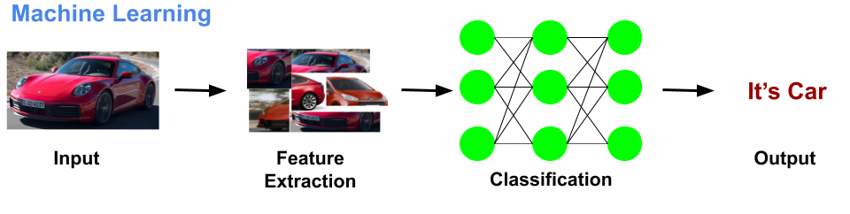
Machine Learning

Slide 3
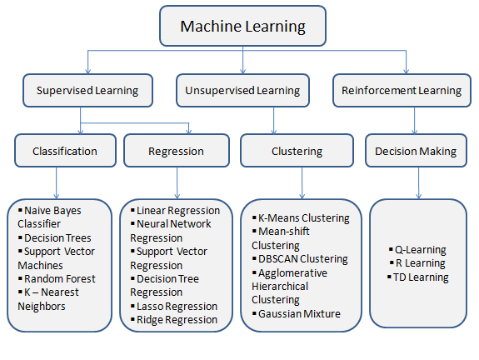
Types of Machine Learning Algorithms
Notes:
Classification example, when filtering emails as ‘spam’ or ‘not spam’, the program must look at existing observational data and filter the emails accordingly.

Slide 4
Agenda
1. Support Vectors
2. Hyperplanes
3. Marginal Distance
4. Linear Separable
5. Non-Linear Separable

Slide 5
Support Vector Machine Algorithm (Supervised Learning - Classification)
Support Vector Machine algorithms are supervised learning models that analyze data used for classification and regression analysis.
They essentially filter data into categories, which is achieved by providing a set of training examples, each set marked as belonging to one or the other of the two categories.
The algorithm then works to build a model that assigns new values to one category or the other.

Slide 6
Linear Separable Points

Slide 7


Slide 8


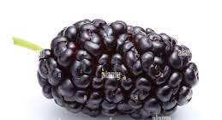
Non-Linear Separable Points
Notes:
Uses a technique called SVM kernals.
Diff Kernal functions are there-linear, polynomial, sigmoid etc
Choosing the right kernel function is crucial or most probably the trickiest part of SVM

Slide 9

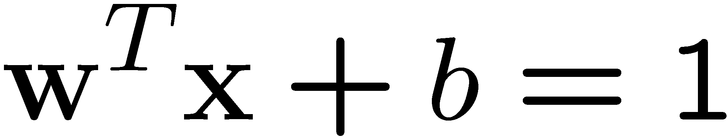
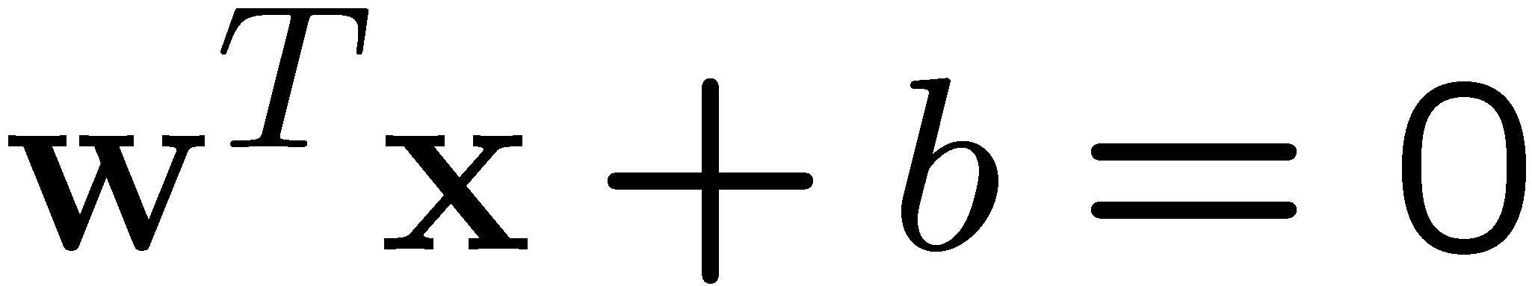
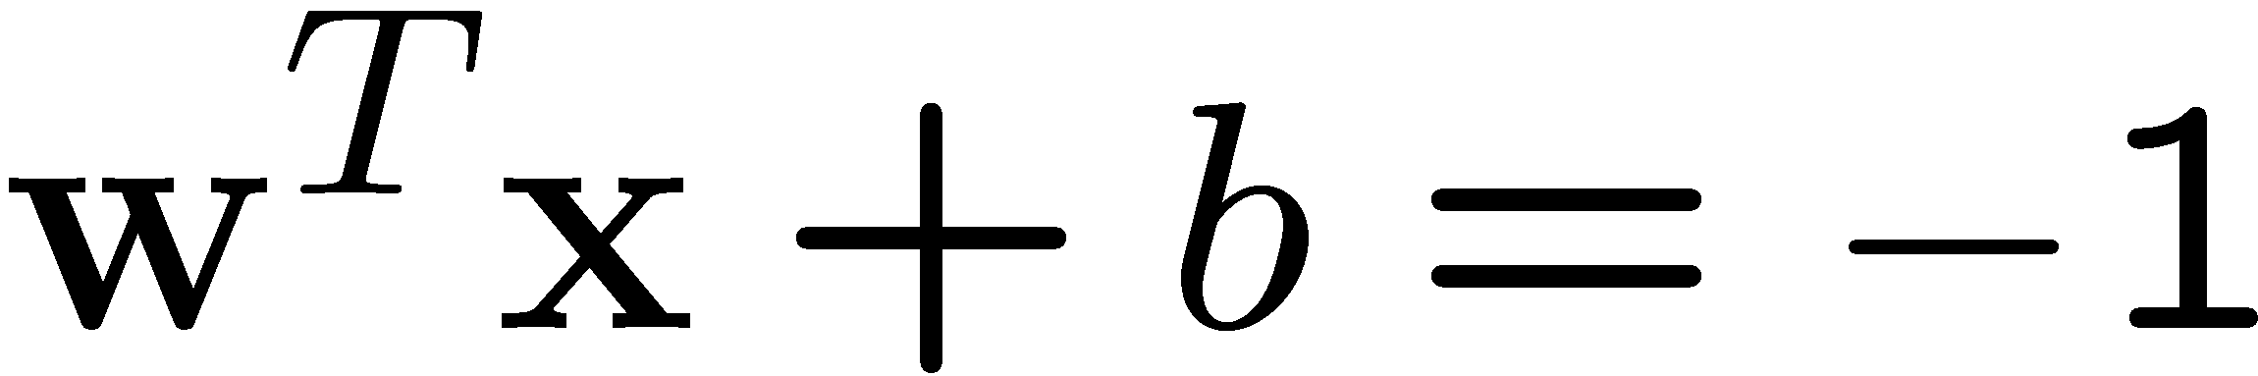
A Geometrical Interpretation
Class 2
Class 1
Notes:
w is a linear combination of a small number of data points
For testing with a new data Z

Slide 10
Software
7 Free SVM TOOLS
KNIME
LIBSVM
mySVM
Orange
RapidMiner
SVM Light
Weka
Notes:
http://www.butleranalytics.com/7-free-svm-tools/
Some implementation (such as LIBSVM) can handle multi-class classification
SVM Light is among one of the earliest implementation of SVM
Several MATLAB toolboxes for SVM are also available

Slide 11
Steps for Classification
Prepare the pattern matrix
Select the kernel function to use
Select the parameter of the kernel function and the value of C
You can use the values suggested by the SVM software, or you can set apart a validation set to determine the values of the parameter
Execute the training algorithm and obtain the α_{i}
Unseen data can be classified using the α_{i} and the support vectors
Notes:
C – Penalty parameter

Slide 12
Advantages
Effective in high dimensional spaces.
Still effective in cases where number of dimensions is greater than the number of samples.
Uses a subset of training points in the decision function (called support vectors), so it is also memory efficient.
Versatile: different Kernel functions can be specified for the decision function. Common kernels are provided, but it is also possible to specify custom kernels.

Slide 13
Disadvantages
If the number of features is much greater than the number of samples, avoid over-fitting in choosing Kernel functions and regularization term is crucial.
SVMs do not directly provide probability estimates, these are calculated using an expensive five-fold cross-validation

Slide 14
Conclusion
SVM is a useful alternative to neural networks
Two key concepts of SVM: maximize the margin and the kernel trick
Many SVM implementations are available on the web for us to try on our data set!

Slide 15
References
https://scikit-learn.org/stable/modules/svm.html#complexity
http://www.butleranalytics.com/7-free-svm-tools/
https://www.sas.com/en_gb/insights/articles/analytics/machine-learning-algorithms.html
https://www.analyticsvidhya.com/blog/2017/09/understaing-support-vector-machine-example-code/
https://www.analyticsvidhya.com/blog/2017/09/understaing-support-vector-machine-example-code/

